Slide 1
GPU Architecture
Amod Malviya
Notes:
Mindset
Reasoning >> Facts
We need to think aloud, not a test
We’ll practice engineering intuition a lot
Don’t trust everything I say

Slide 2
High Level Overview
Break (10 mins)
Hardware Deep Dive
Break (10 mins)
Memory & Performance

Slide 3
High Level Overview

Slide 4
Basics
Amdahl’s Law
Everything has a latency
Throughput hides latency (when correctly used)

Slide 5


A simplified model
of GPU
CPU
Memory
Nature of CPU – GPU talk?
async !
x16 lanes
Core
Core
Core
Core
What kinds of talk?
100+ns
PCI Express
Initialization
Memory alloc/dealloc
Data Transfer
Execute Code
Core
Core
Core
Core
Core
Core
Core
Core
Core
Core
Core
Core
GPU
PCIe 4.0: 16Gbps/lane
Notes:
Device vs Host timeline
Demo: CPU vs GPU – which is faster? Multiply with min parallelisation

Slide 6
High level program flow
Initialise
Allocate memory on GPU & copy data
Set up compute pipelines (specify flow of kernels/shaders)
Submit the pipeline for execution on GPU
Wait for completion
Read data from GPU
Free all resources

Slide 7
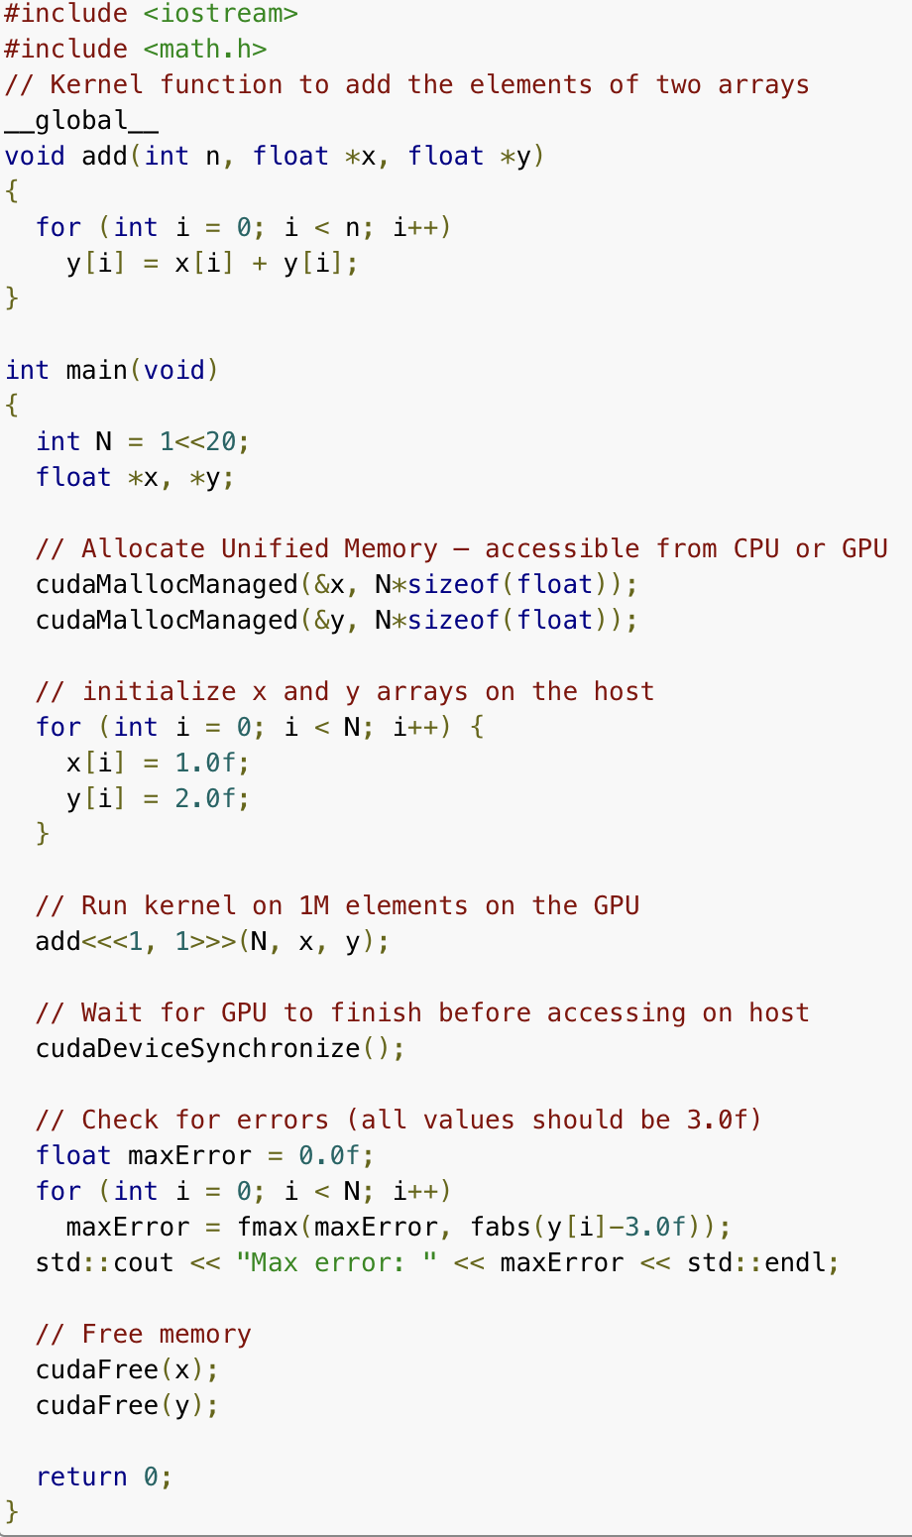

GPU
SQ
CQ
In case of WebGPU?
CPU
Notes:
Q: Any idea about how CPU – GPU talk most of the time? System calls?
The kernel itself is also communicated via SQ/CQ

Slide 8
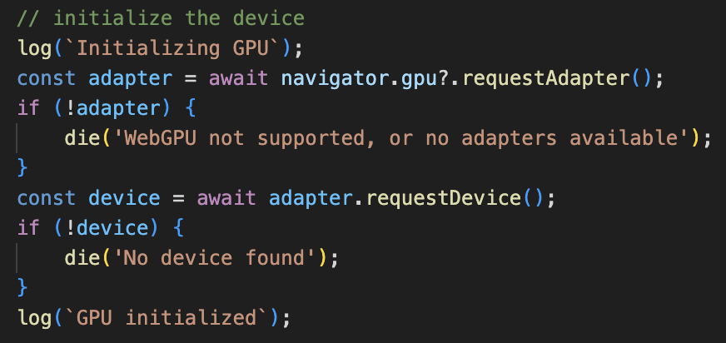
Initialization
The main reference through which we interact with the GPU
File: vec-multiply.html

Slide 9
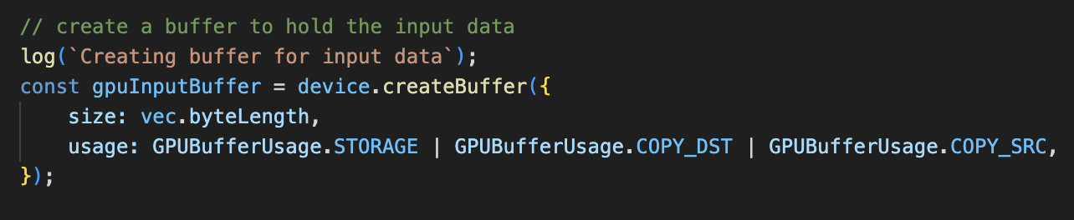
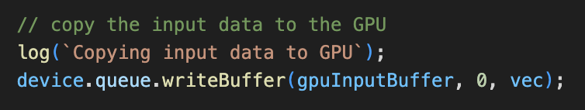
GPU Memory Allocation & Data Copy
Allocate memory on GPU
Size of memory
Purpose
CPU → GPU data copy
File: vec-multiply.html
Notes:
Other kinds of buffers – UBO, Vertex etc.

Slide 10
Compute Kernels The “logic” in GPU

Slide 11
…
Threads
Work Items
Invocations
…
Thread block Workgroup
0
1
2
3
Grid
Notes:
Each thread is executing exactly the same code (but with awareness of itself)
Q: Why do we need to group threads?

Slide 12
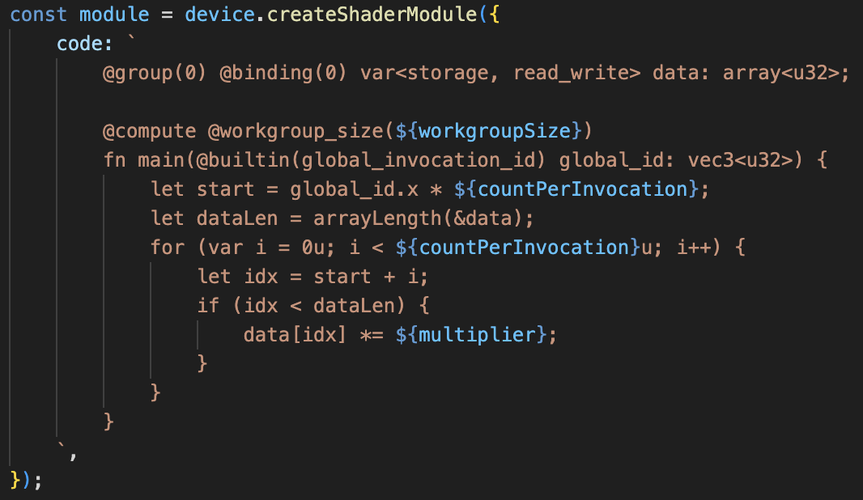
A kernel needs to infer its target work section from its topology
Array scalar multiplication
input array
WGSL
start_index
our position in the grid topology
Kernel / Shader
width
Unit of work
width
why do we need this condition?
Notes:
WGSL: Rust-y syntax
Q: How does it get compiled to GPU’s machine code?

Slide 13
Memory
Scheduler
Register Files
Core
Core
Core
Core
n-lane SIMD
Core
Core
Core
Core
n-lane SIMD
Core
Core
Core
Core
n-lane SIMD
Warp / Wavefronts
Core
Core
Core
Core
Memory Cache
What if there’s not enough capacity for all the threads in a workgroup?
Notes:
Explain: why we need the "if" condition from before
Each block is guaranteed to execute on the same ”core”, but can be split into multiple warps
Explain: context switching between warps
Explain: prior reservation of resources
There _has_ to be a limit on maximum thread groups
And a limit on max threads per group

Slide 14
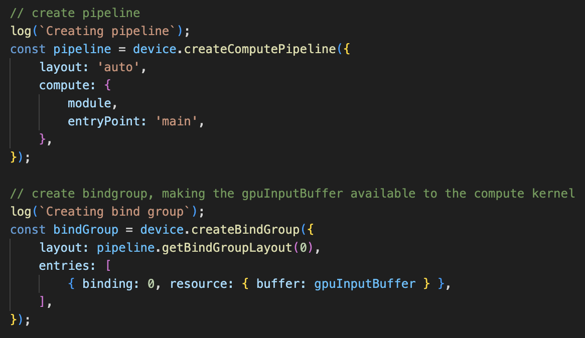
GPU code – kernels need context

Slide 15
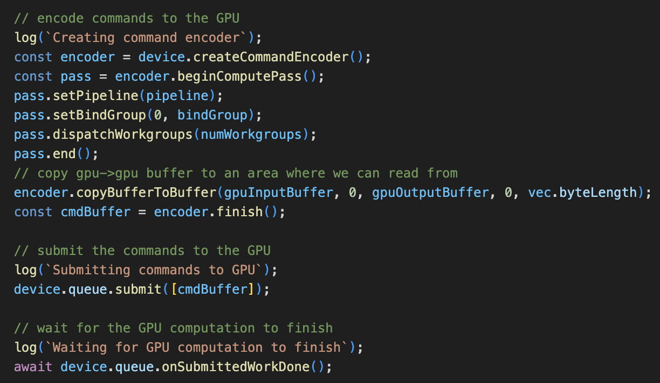
GPU code – get cranking!
Data context for
kernel
Execute ‘n’
workgroups of the kernel
GPU → GPU
data transfer

Slide 16
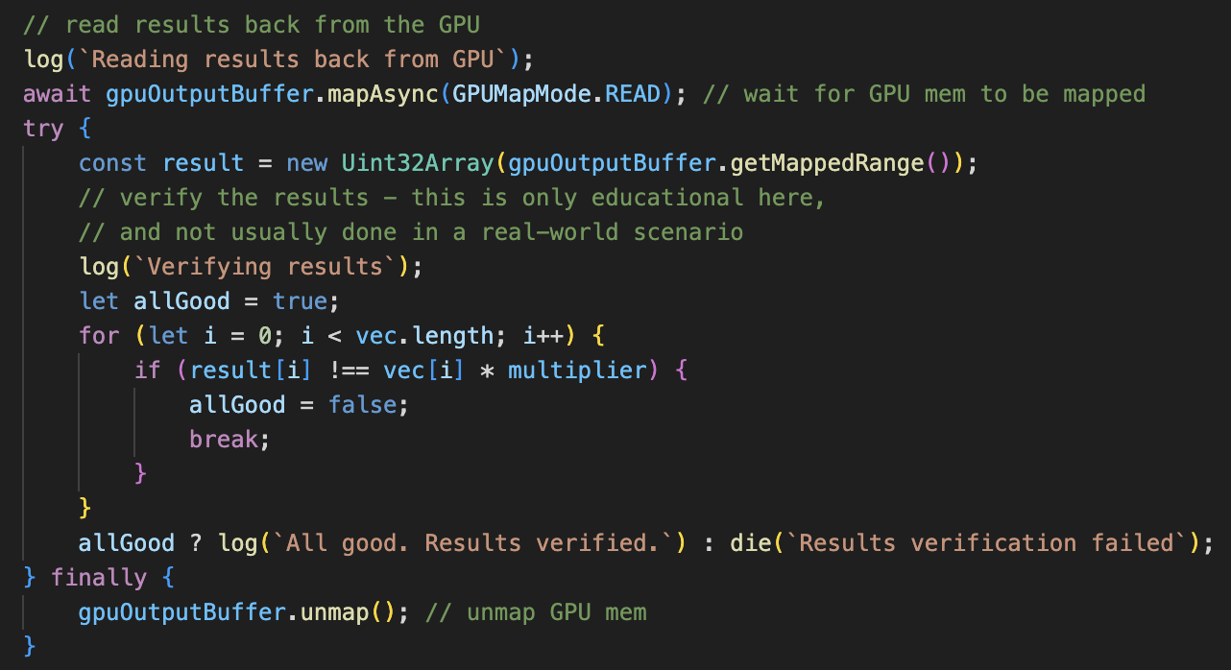
Data Transfer: GPU → CPU
File: vec-multiply.html
Notes:
Q: Why does CPU -> GPU copy have a dedicated method, while GPU -> CPU does not?
Assignment: Why GPU memory needs to be mapped before copy to CPU?

Slide 17
WebGPU Shader Flow
Browser
WGSL
Compiler
Microsoft
HLSL
Direct3D
Apple
MSL
Metal
Others
SPIR-V
Vulkan

Slide 18
Matrix Multiplication?
X
=
Notes:
Q: How should we think about grid topology here?

Slide 19
Break

Slide 20
Hardware Deep Dive

Slide 21
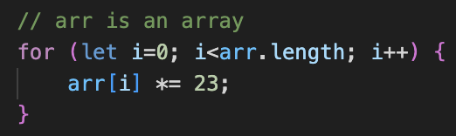
Multiplying an array
CPU core
%eip
%ebx
%edx
%eax
…
23
…
SISD
imul %ebx, %edx, %eax
x
=
…
ALU (INT EU)
…
Machine Code
The true “compute” provider
Notes:
Demo: doubling array size doubles CPU time, but not GPU time (Amdahl’s Law in case of GPU)

Slide 22
SIMD
64x 8-bit numbers
32x 16-bit numbers
16x 32-bit numbers
ZMM0 – 512-bit register
x
_mm512_mul_epu32 ( __mm512i array1, __mm512i array2)
ZMM1 – 512-bit register
filled with ”23”
=
16x 32-bit multiplications!
Still on CPU
Requires more EUs
ZMM2 – 512-bit register
ALU (INT EU)
Notes:
History on x86: MMX -> SSE (1/2/3/4) -> AVX (1/2/512)
Limitations – less flexible, control flow missing, exposes width

Slide 23

CPU vs GPU
Is it really so simple? What are the tradeoffs?
Control
Control
Control
Control
Control
Control
ALU
ALU
ALU
ALU
ALU
ALU
ALU
ALU
ALU
ALU
ALU
ALU
ALU
ALU
ALU
ALU
ALU
ALU
ALU
ALU
ALU
ALU
ALU
ALU
ALU
ALU
ALU
ALU
ALU
ALU
ALU
ALU
ALU
ALU
ALU
ALU
ALU
ALU
ALU
ALU
ALU
ALU
ALU
ALU
ALU
ALU
ALU
ALU
ALU
ALU
ALU
ALU
ALU
ALU
ALU
ALU
ALU
ALU
ALU
ALU
ALU
ALU
ALU
ALU
ALU
ALU
ALU
ALU
ALU
ALU
ALU
ALU
ALU
ALU
ALU
ALU
ALU
ALU
ALU
ALU
ALU
ALU
ALU
ALU
PCIe
PCIe
CPU core
CPU core
GPU Global Memory
Memory
Notes:
Latency vs throughput oriented design
Q: How good are CPUs in latency?
Demo: min parallelization
Q: Cost of high memory bandwidth in GPUs? Higher cost of manufacturing.

Slide 24
SIMT
Registers →
Divergent Control Flow
Thread 1
Thread 2
Thread 3
Thread 4
Thread 5
→
…
An executing thread group will block on
longest thread (e.g. for loop)
→
…
→
if (…)
→
…
if/else are executed serially
(in the same executing thread group)
→
…
→
else
→
…
→
// end if
→
…
Notes:
Demo: Heavy workload demo
Once started, cannot stop
Q: Does the “if” boundary condition from before lead to control divergence?
Assignment: Reflect on how SIMD is different from SIMT. Both seem to be doing the same job, isn’t it?

Slide 25
Scheduler
Register Files
m-lane SIMD
INT32 cores
n-lane SIMD
FP32 cores
x-lane SIMD
Matrix cores
Memory Cache
Notes:
Q: Why would we want to have different number of lanes?
Q: Can different cores be active at the same time?
Q: What’s the typical size of memory cache?
Q: Why is it so small?
Q: Why do we split up blocks into warps?

Slide 26
Hardware - NVIDIA

Slide 27
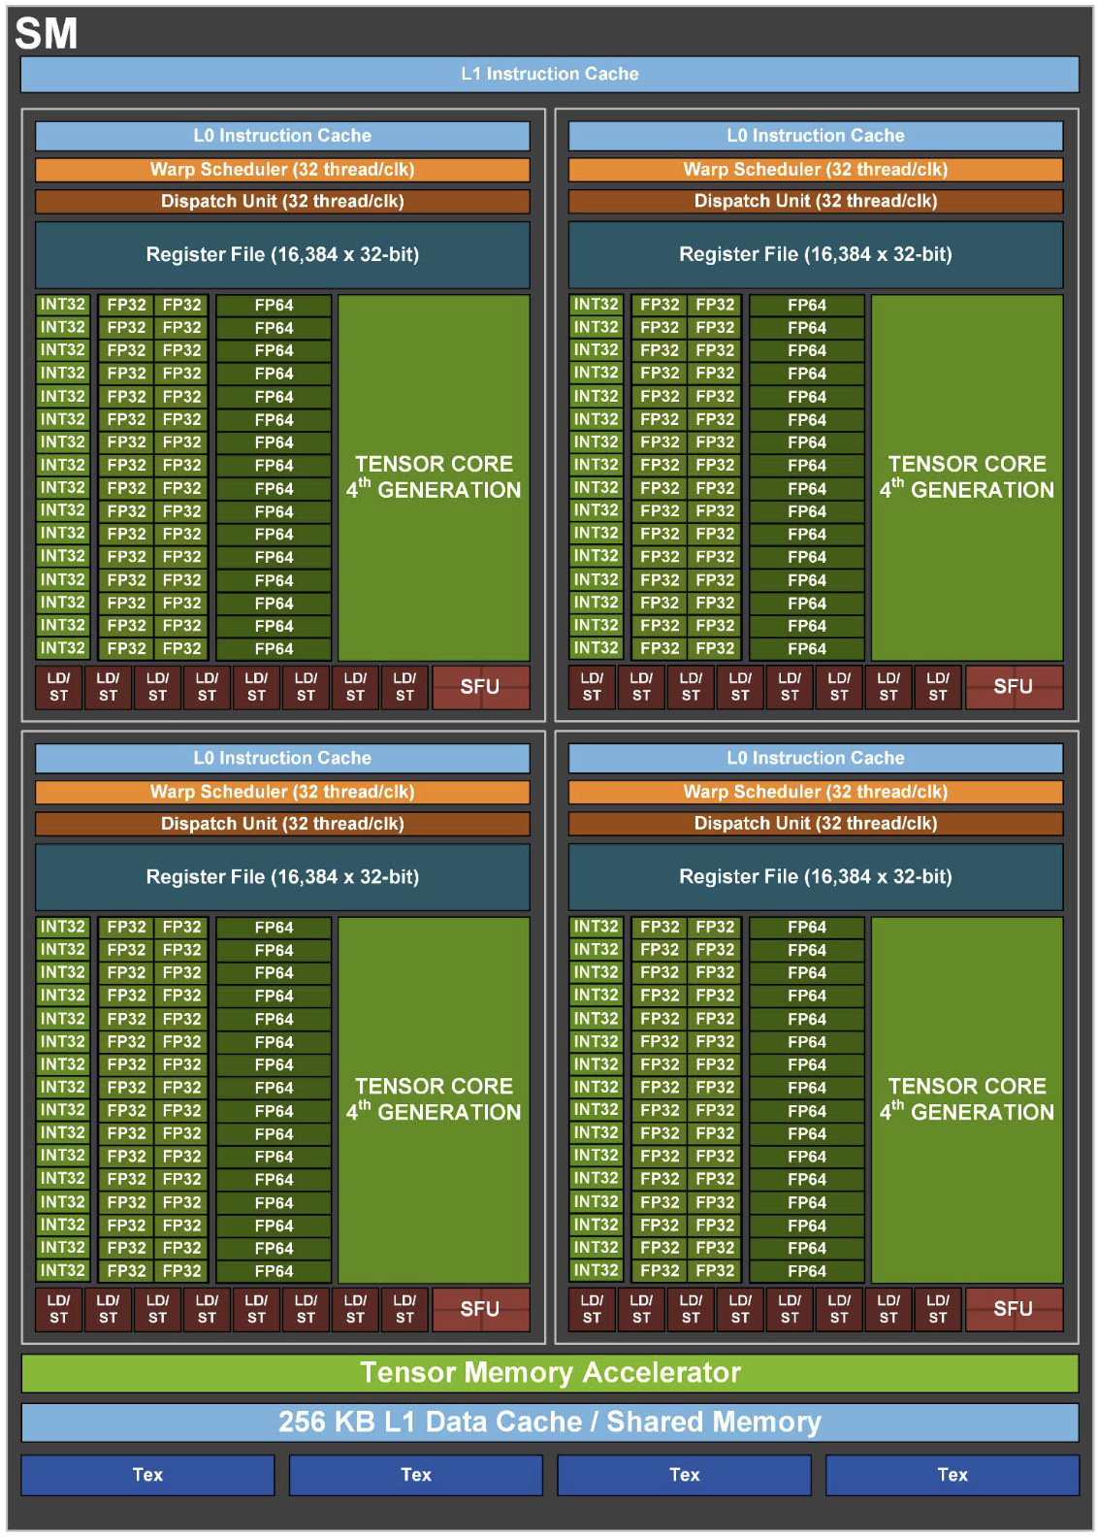
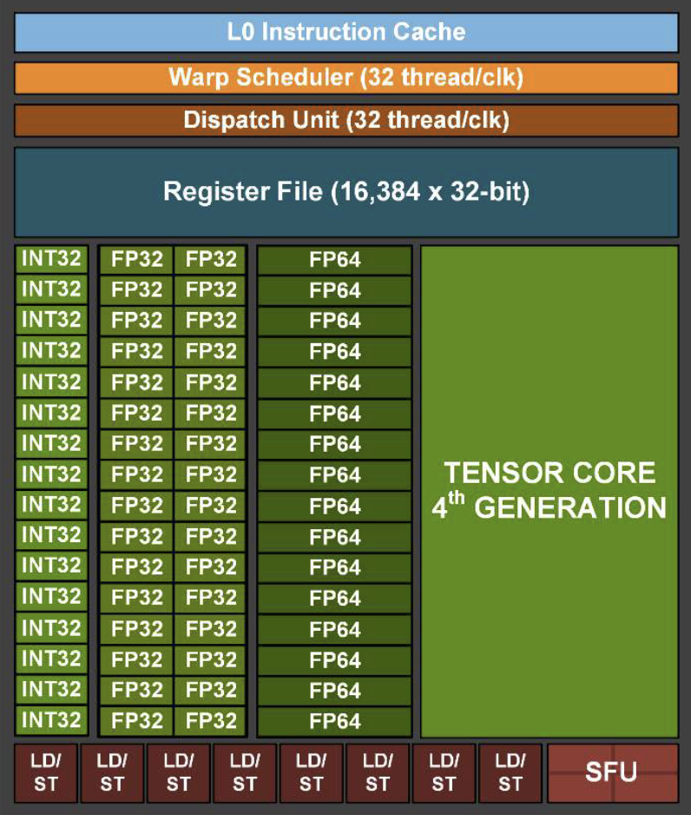
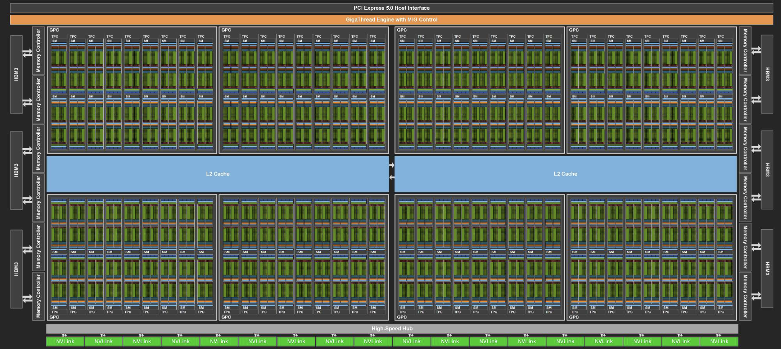
NVIDIA H100 Architecture
Notes:
4x 16-lane SIMD for INT32

Slide 28
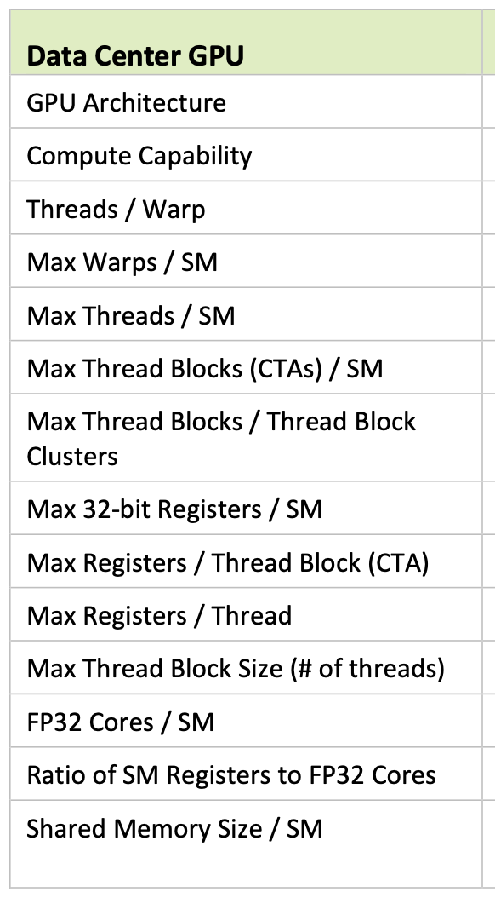
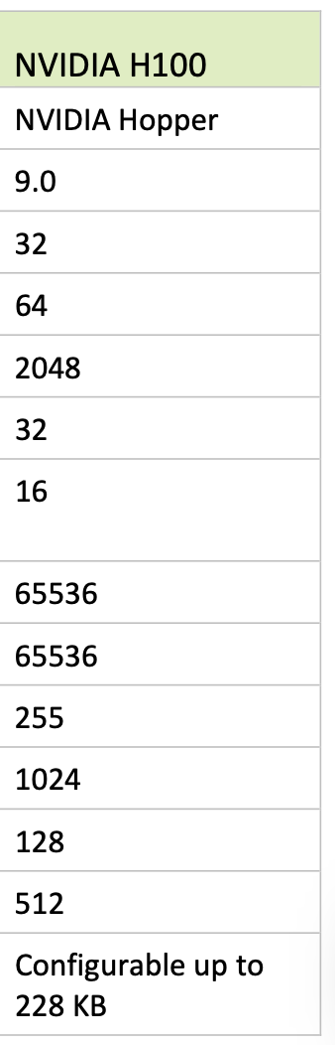

Slide 29
Hardware - AMD

Slide 30
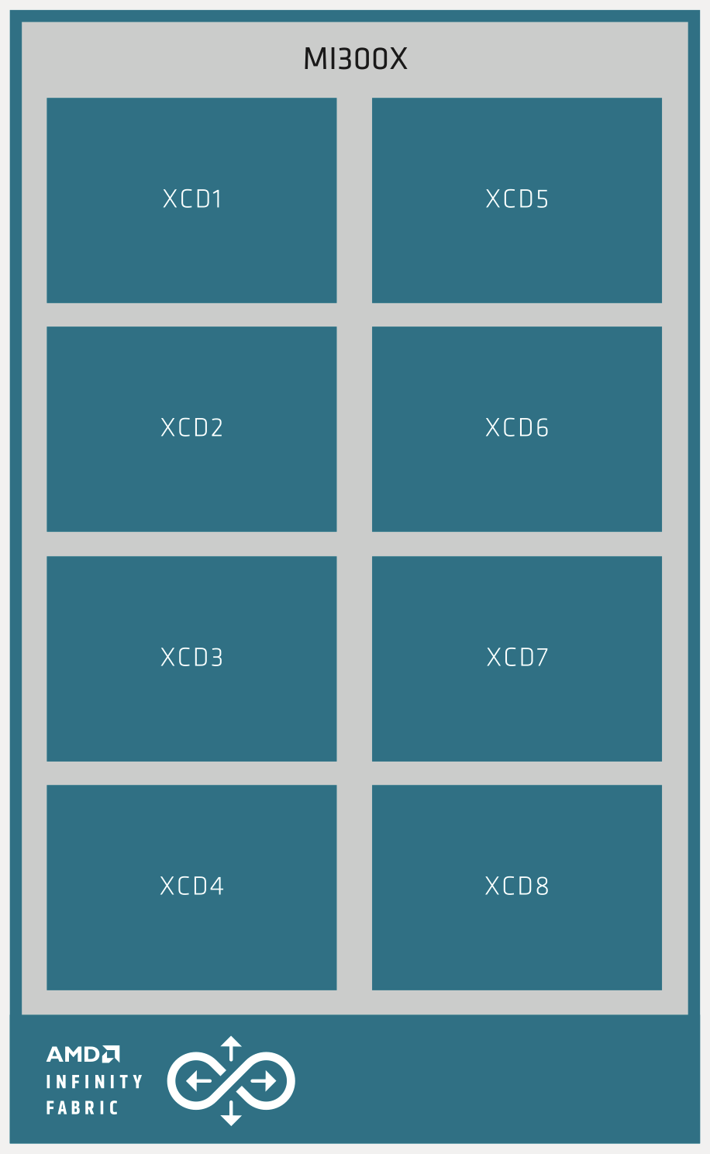
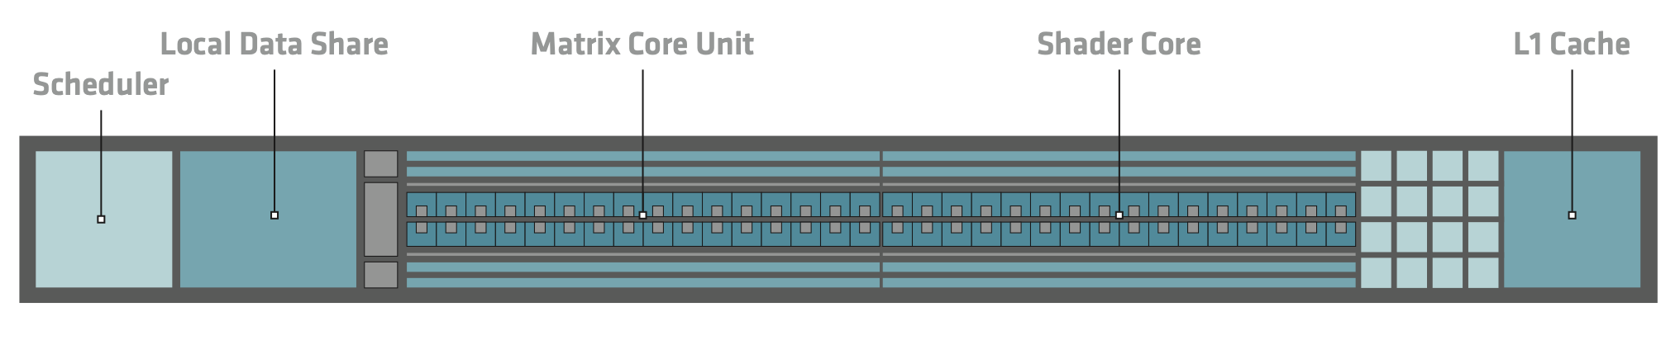
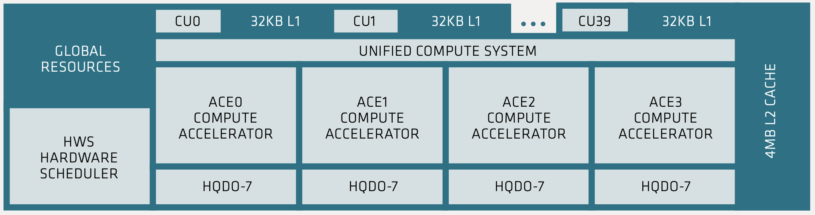
AMD CDNA3 whitepaper

Slide 31
Hardware - Intel

Slide 32
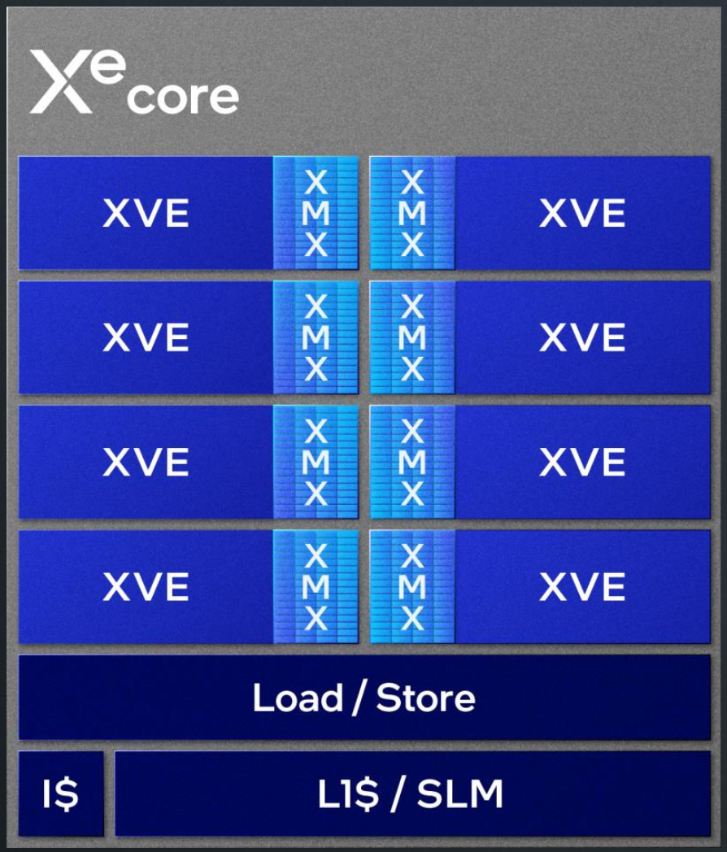
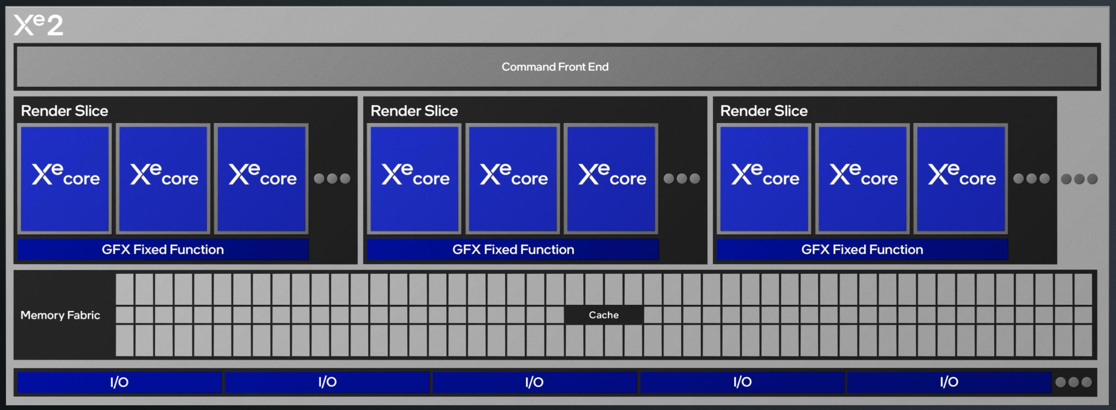
https://www.intel.com/content/www/us/en/content-details/824434/2024-intel-tech-tour-xe2-and-lunar-lake-s-gpu.html
Notes:
Each Xe core:
8x 512b vector engine
8x 2048b XMX engine
192KB Shared L1 / SLM

Slide 33
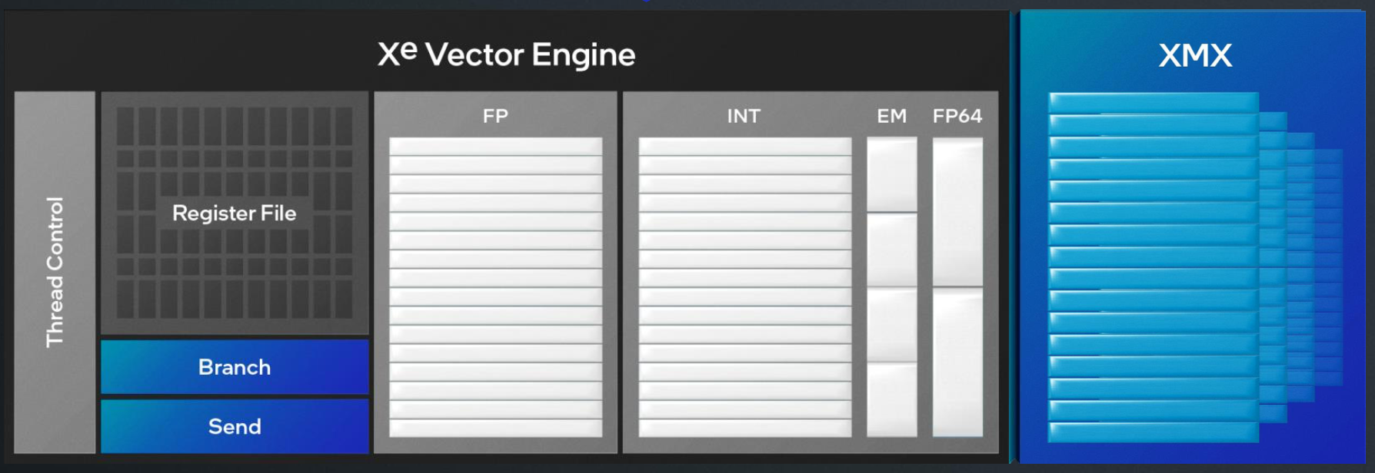
https://www.intel.com/content/www/us/en/content-details/824434/2024-intel-tech-tour-xe2-and-lunar-lake-s-gpu.html
Notes:
XMX: Xe Matrix eXtensions

Slide 34
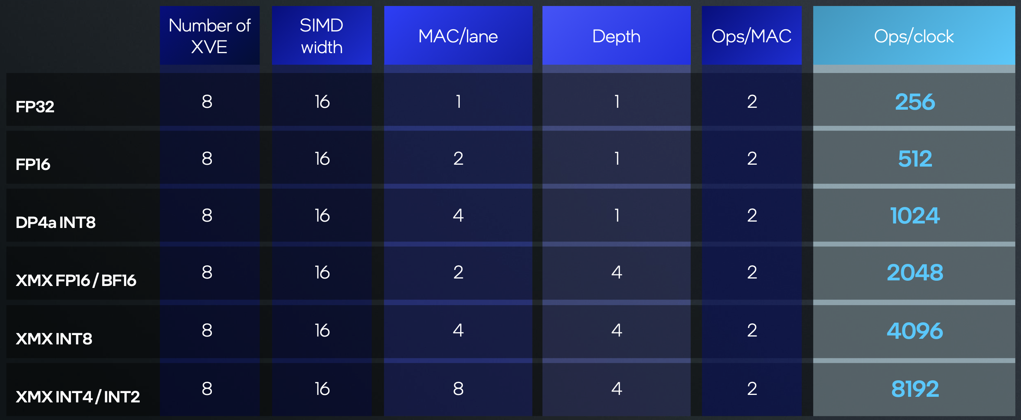
https://www.intel.com/content/www/us/en/content-details/824434/2024-intel-tech-tour-xe2-and-lunar-lake-s-gpu.html

Slide 35
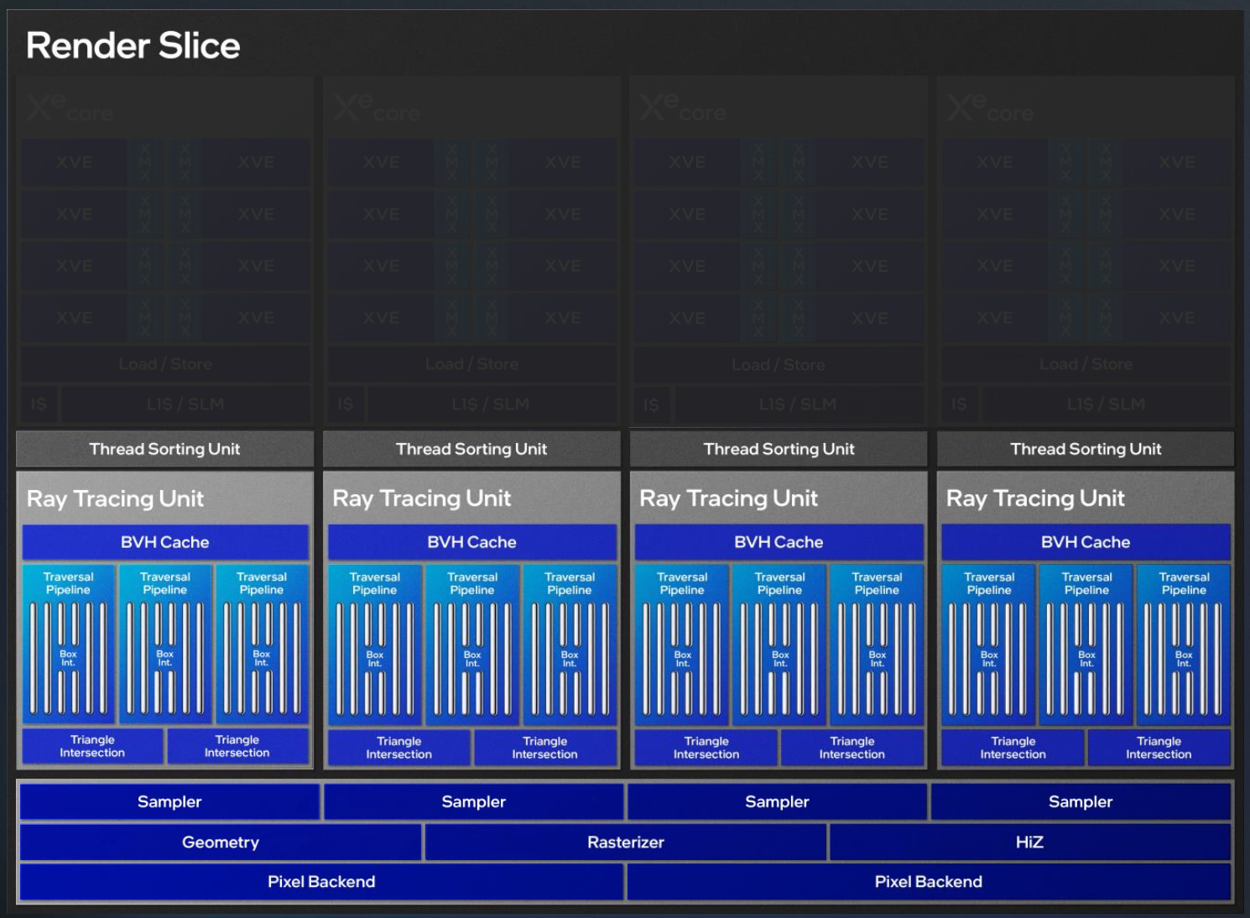
https://www.intel.com/content/www/us/en/content-details/824434/2024-intel-tech-tour-xe2-and-lunar-lake-s-gpu.html
Notes:
Intel Lunar Lake will be using 2x of these, so 8 Xe2 cores + 8 RT units

Slide 36
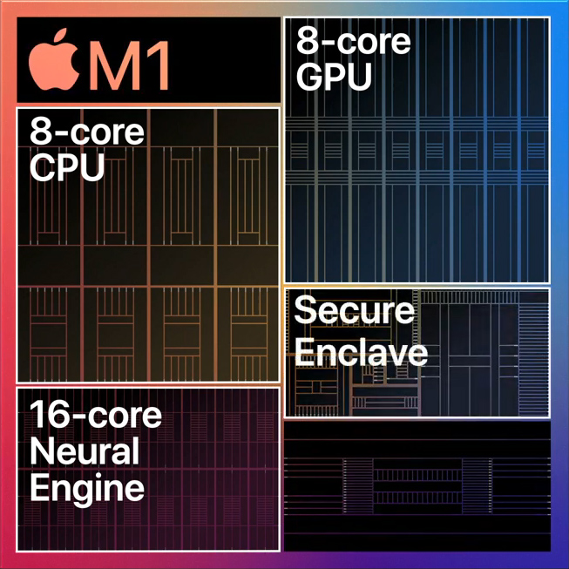
Apple – GPU vs Neural Engine
Shader cores, RT cores
Metal / MPS
Usual CPU
Std languages/runtime
Tensor core type stuff
INT8, INT16, FP16
CoreML
Source: https://apple.fandom.com/wiki/Neural_Engine
Notes:
Why – more efficient (specialized) than GPU, and leaves GPU free for graphcis
No public info – assumed to have INT8, INT16 and FP16 support
Most NPUs are designed for inference, not training.

Slide 37
Break

Slide 38
Memory & Performance

Slide 39
A
B
C
X
=
What’s the ops/B ?
Notes:
2 OP to 8 bytes per cell of A & B

Slide 40
Roofline Model
Max Throughput (GOPS)
Max Bandwidth (GB/s)
T3
Computational Throughput (GOPS)
T1
T2
Computational Intensity (OPS/B)
Notes:
Q: Do you see now why GPU memory bandwidths are so important?

Slide 41
Scheduler
Scheduler
Register Files
Register Files
Global Memory
(VRAM)
m-lane SIMD
m-lane SIMD
n-lane SIMD
n-lane SIMD
x-lane SIMD
x-lane SIMD
L1 + Local
L1 + Local
Capacitive Memory
(Large + Slow)
SRAM
(Small + Fast)
L2 Cache
Notes:
Q: Why is capacitive memory slow, while SRAM fast?
Q: Memory bandwidth of H100?

Slide 42
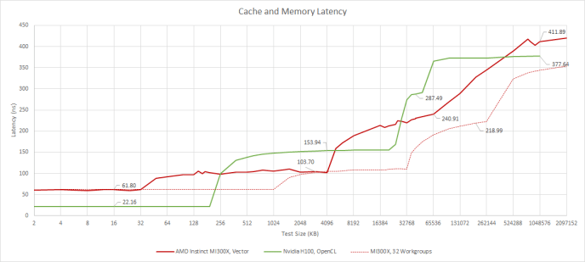
https://chipsandcheese.com/2024/06/25/testing-amds-giant-mi300x/

Slide 43
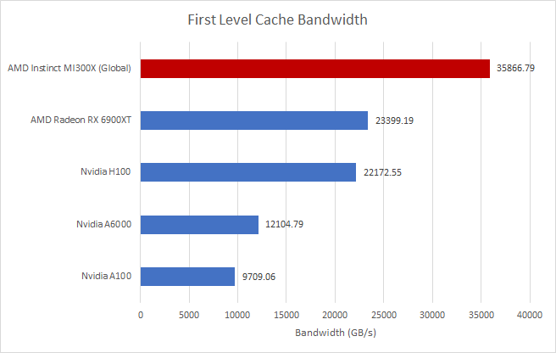
https://chipsandcheese.com/2024/06/25/testing-amds-giant-mi300x/

Slide 44
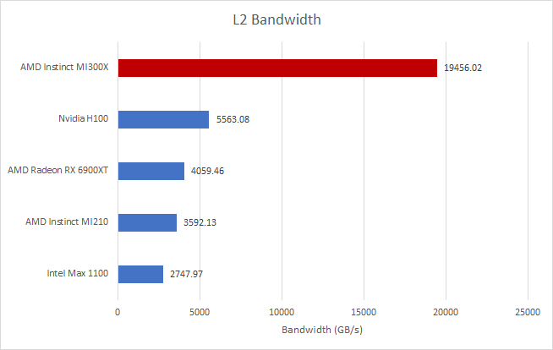
https://chipsandcheese.com/2024/06/25/testing-amds-giant-mi300x/

Slide 45
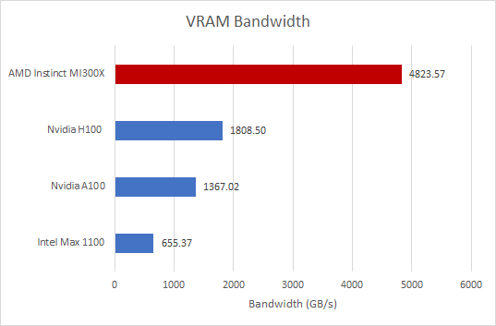
https://chipsandcheese.com/2024/06/25/testing-amds-giant-mi300x/

Slide 46
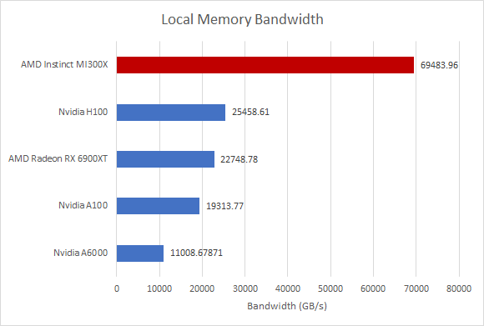
https://chipsandcheese.com/2024/06/25/testing-amds-giant-mi300x/

Slide 47
Can we do better?
A
B
C
X
=
Caching?
Notes:
Q: Do we see the advantage of spatial locality in a threadgroup now?
Q: What about B-transpose?

Slide 48
Tiling
A
B
C
X
=
A1
A2
B1
B2
C1
C2
A3
A4
B3
B4
C3
C4
Notes:
Assignment: implement tiling

Slide 49
Optimisations
Maximising occupancy
Coalesced access for global memory
Minimising control divergence
Tiling of reused data
Privatisation
Thread coarsening
Programming Massively Parallel Processors – Hwu, Kirk, Hajj

Slide 50
Thank you
Notes:
Congratulations: now you know more about GPUs than 99% of BLR’s software engineers!
Assignment: (Puzzle) Idx-Add-Mul vs Num-Add-Mul – CPU vs GPU. Explain.

